Slide 1
Introduction to Programming
Ctrl+Alt+Elite

Slide 2
Basic Programming
We will learn about:
Introduce programming structures
If-Statements
Booleans
Basic Variables
Writing a program in Cygwin

Slide 3
Programming Structures
Sequence
Execute a list of statements in order.
Think of it like a recipe that you have to follow in order.
Example: Baking Bread
Add flour.
Add salt.
Add yeast.
Mix.
Add water.
Knead.
Let rise.
Bake.
Notes:
Activity: PB&J’s
First, ask the students to create and write down a simple recipe on making a PB&J. The student’s can be detailed if they want on the activity.
Once students have completed and using a blank slide or whiteboard, work with the students and have them tell you what the recipe is and write it down.
This allows the students to present their ideas and even make changes if the recipe gets out of order.

Slide 4
Programming Structures
2) Repetition
Repeat a block of statements while a condition is true.
Example: Washing Dishes
Stack the dishes by sink.
Fill the sink with hot soapy water.
while Dishes -> while there are still dishes in sink
Get a remaining dish from the counter,
Wash the dish,
Put the dish in the drain rack.
End while Dishes loop
Wipe off the counter.
Rinse out the sink.
END

Slide 5
Programming Structures
3) Selection
Choose at most one action from several alternative conditions.
Example: Sorting Mail
Get mail from mailbox.
Put mail on table.
While moreMailToSort
Get piece of mail from table.
If pieceIsPersonal Then
Read it.
ElseIf pieceIsMagazine Then
Put in magazine rack.
ElseIf pieceIsBill Then
Pay it,
ElseIf pieceIsJunkMail Then
Throw in wastebasket.
End If
End While

Slide 6
Variables
Integers
An integer is a whole number (not a fraction) that can be positive, negative, or zero.
Integers cannot have decimal places.
When two integers are added, subtracted, or multiplied, the result is also an integer.
Example: int x;

Slide 7
Variables
Double
Double are used to define numeric variables holding numbers with decimal points.
A double type can represent fractional as well as whole values.
In other words, a double allows us to display decimal values, such as pi = 3.1415
int will only show pi = 3
Example: double num;
Notes:
*Num is for number*

Slide 8
Variables
String
A string is a variable that stores a sequence of letters or other characters, such as "Hello" or "May 10th is my birthday!".
Ex:
string testString;
testString = "This is a string.";

Slide 9
If-Statements
An If-Then Statement is a statement with a hypothesis followed by a conclusion. Another way to define a conditional statement is to say, “If this happens, then that will happen.”
The hypothesis is the first, or “if,” part of a conditional statement. The conclusion is the second, or “then,” part of a conditional statement.

Slide 10
If-Statements (Cont.)
if (condition) {//statement(s)};
If you work overtime, then you’ll be paid time-and-a-half.
If my homework is done then I can go outside to play.
If I finish dinner then I can have dessert.
Ex:
if (x > 120) digitalWrite(LEDpin, HIGH);
If (x == 10) {cout << “Answer is 10”; }

Slide 11

How to use Atom
Atom is a free and open-source text and source code editor. We are using this for C++ coding.
Open up the Atom icon.
Open a new file if one isn’t already up.
You should see a blank screen to begin coding.
Notes:
Icon Source: https://dashboard.snapcraft.io/site_media/appmedia/2017/04/atom-256px.png

Slide 12
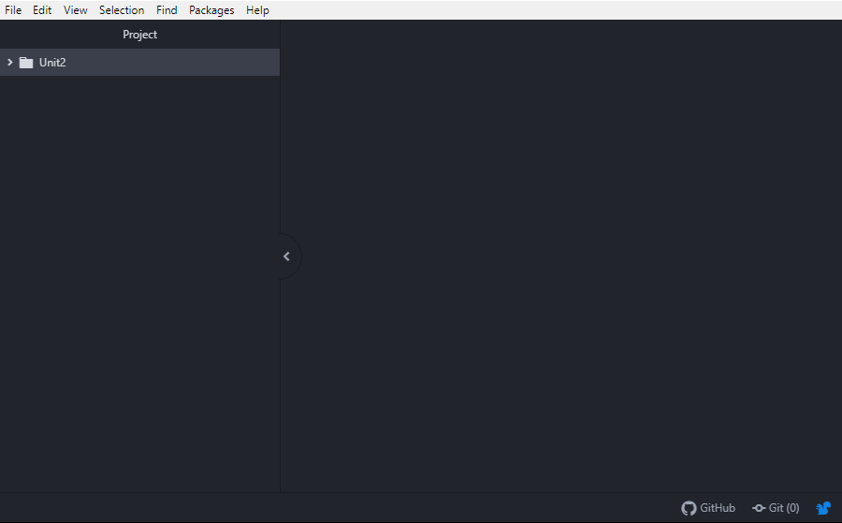
How to use Atom
Atom should look similar to this:
Notes:
Background of Atom may be Light or Dark - depending on the theme installed.

Slide 13
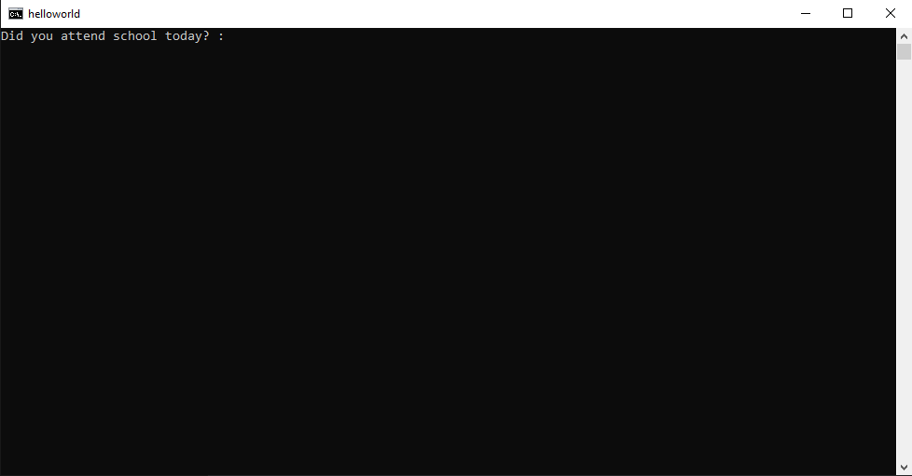
How to use Atom
Using the compiler:
Press F5 to compile
A terminal will pop up and will begin running your program immediately.

Slide 14
Programming in Atom
Using Atom’s IDE we are able to write code.
The code we will be writing is in C++.
Example of C++ coding:
// This program prints a greeting.
#include <iostream>
using namespace std;
int main(void)
{
cout << "Hello!\n";
return 0;
}
Notes:
The example program in this slide prints the word: Hello!

Slide 15
Programming in Atom
Some key things to consider when using C++
#include <iostream> ← Type this at the top of your code!
This is a library call to iostream, which provides functions for cin and cout.
Using namespace std; ← Type this at the top of your code!
We will be using this for all cin and cout function calls
Case sensitivity in programming
All functions used in programming are case sensitive.
Example: int Hello; is not equal int hello;

Slide 16
Programming in Atom
Some key things to consider when using C++
int main(void)
This is used for the compiler to understand and run all code inside the main function.
cout << “string”;
This is used to print whatever is inside the prints out on the screen.
cin >> variablename;
This is used to take input from the user and store it into a variable

Slide 17
Programming in Atom
Lets try programming in Atom!
Write a program that prints Hello world!
Remember you will need:
#include <iostream>
using namespace std;
Notes:
#include <iostream>
using namespace std;
int main(void)
{
cout << "Hello!\n";
return 0;
}

Slide 18
Programming in Atom
Just a reminder
If you are seeing little red squiggly lines underneath a word, hover your mouse over that word to see what is wrong.
You may have a typo or did not define a variable to use.
Notes:
#include <iostream>
using namespace std;
int main(void)
{
cout << "Hello!\n";
return 0;
}

Slide 19
Programming in Atom
Did your program look similar to this?
#include <iostream>
using namespace std;
int main(void)
{
cout << "Hello world!”;
return 0;
}
Notes:
#include <iostream>
using namespace std;
int main(void)
{
cout << "Hello!\n";
return 0;
}

Slide 20
Programming in Atom
Lets try something else!
Suppose we want to take user input and then print what was typed.
Write a program that asks for your first name and then have it print out your name.
Example: Hello, john
Notes:
#include <iostream>
using namespace std;
int main(void)
{
string myname;
cout << "Enter your name: ";
cin >> myname;
cout << "Hello " << myname;
return 0;
}

Slide 21
Programming in Atom
#include <iostream>
using namespace std;
int main(void)
{
string myName;
cout << "Enter your name: ";
cin >> myName;
cout << "Hello " << myName;
return 0;
}

Slide 22
Programming in Atom
Now that we have experienced how to write our C++ code using cin, cout, and a variable as an integer; let’s try another one, but with a conditional this time.

Slide 23
Programming in Atom
Write a program that asks if you had school today or not and take that input as a y or a n and output the results. If y is chosen, have the program output “You did have school today.”, if n is chosen, have the program output “You did not have school today.”
Hint: You will need to use an if statement

Slide 24
Programming in Atom
#include <iostream>
using namespace std;
int main() {
string answer;
cout << "Did you attend school today? :";
cin >> answer;
if (answer == "y")
{
cout << "You did have school today!";
}
if (answer == "n")
{
cout << "you did not have school today!";
}
return 0;
}
Your program may be similar to this:

